Slide 1
Hypersensitivity Reactions III & IV
DR MANOJ RADHAKRISHNAN
DEPT OF PATHOLOGY AND MICROBIOLOGY
SKHMC

Slide 2
Type III Hypersensitivity(Immune complex-mediated)
Binding of Ag-Ab complexes that trigger complement activation
Complexes may form locally in tissues or in circulation aggregated Fc regions of Ig G antibodies activatecomplement and lead to incrsd vasc permeability ,activation of neutrophils and tissue necrosis
Antigens capable of eliciting type III reaction-exogenous(streptococcal Ag,Hep B virus,heroin) or endogenous(immunoglobulins &nuclear antigens)

Slide 3
Prototype of Type III HS ,serum sickness
Large amounts of foreign serum were adminstered for passive immunization(eg Horse serum containing anti-diphtheria Ab)
Approx 5 days later Ab to Ab is synthesized.these react to form Ag-Ab complexes.
These complexes deposit in blood vessels triggering injurious inflammatory reactions.
Very large complexes are removed by macrophages
Small or intermediate sized complexes circulate longer and get deposited I kidneys, joints and small blood vessels.

Slide 4
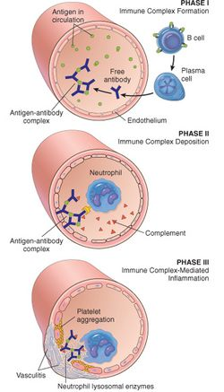

Slide 5
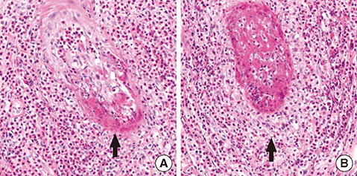
Necrotizing vasculitis & fibrinoid necrosis

Slide 6
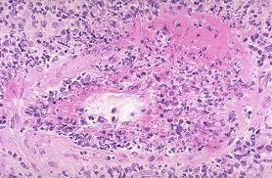
Vasculitis due to Anti-neutrophil cytoplasmic Ab

Slide 7
Imp diseases-Type III
Disease | Antigen involved | Clinico-pathological manifestations
Systemic lupus erythematosus | Nuclear Ag | Nephritis , skin lesions, others
Post-streptococcal Glomerulo-nephritis | Streptococcal cell wall Ag maybe deposited in GBM | Nephritis
Polyarteritis nodosa | Hepatitis B virus Ag | Systemic vasculitis
Reactive arthritis | Bacterial Ag | Acute arthritis
Serum sickness | Foreign Ag (anti-diphteritic Ab, or anti-thymocyte Ab) | Arthritis, vasculitis, nephritis
Arthus reaction | Local type of Type III seen in skin | Cutaneous vasculitis.

Slide 8
Type IV Hypersensitivity(Th1 CD4 & CD8 Lymphocyte mediated)
Also called T-cell mediated or delayed type hypersensitivity
A classic example is tuberculin reaction: in a previously sensitized individual (exposed to Myc Tub),intracut injection of PPD of M.Tub cultures will lead to delayed (8-12hrs) redness & induration that peaks in 72 hrs.
Redness & edema due to cytokine secretion.
Charact by perivascular cuffing by CD4+ T Cells
if the antigen is non degradable perivascular lymphocytes are replaced by epithelioid Cells.
Contact dermatitis is also example (poison ivy allergy)(rhus tox)
CD 8+ mediated cell death in graft rejection

Slide 9
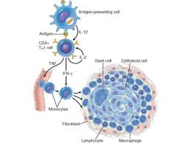
Granuloma formation eg of Type IV

Slide 10
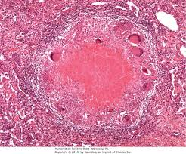
T B granuloma with caseous necrosis

